Slide 1

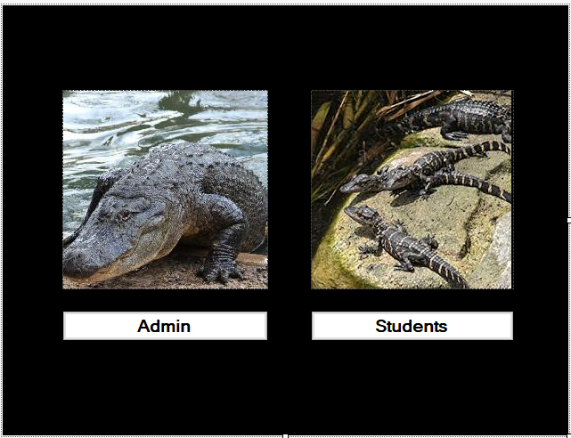
Blackboard
by: Earnest Teamer, Andrew Nguyen. Daniyal Raoofi, Hassan Alsalman , Keaton Alexander

Slide 2
Team info
Team Model: Democratic
Tools Used: Discord, GroupMe , Trello, SQL Server Management Studio, Lucid Chart, GitHub, Visual Studio , .NET Framework C# , Google Documents, Gmail, Google.com, MS Office Suite, TeamViewer
Andrew and Earnest: Design Implementation ( Programming )
Hassan and Keaton: Documentation
Daniyal : UML Diagram & PowerPoint
https://github.com/A-TNguyen/BlackBoard_Application

Slide 3
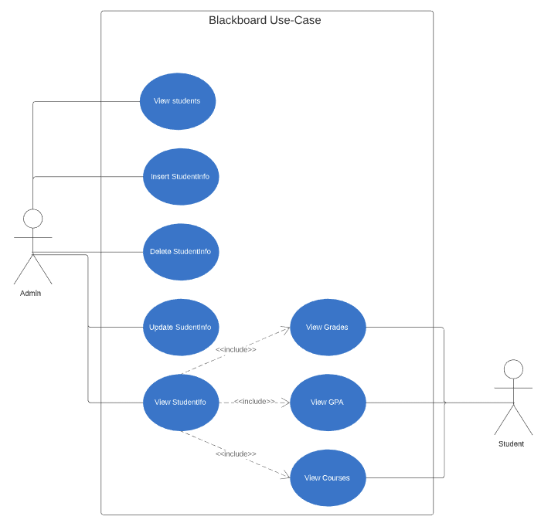
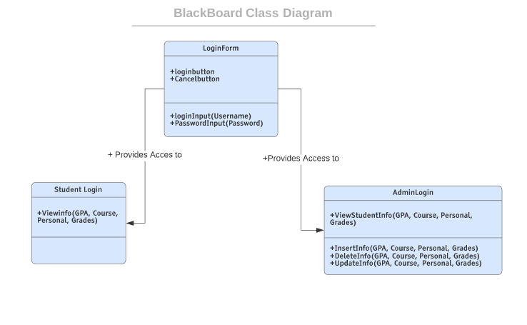
UML Diagram’s

Slide 4
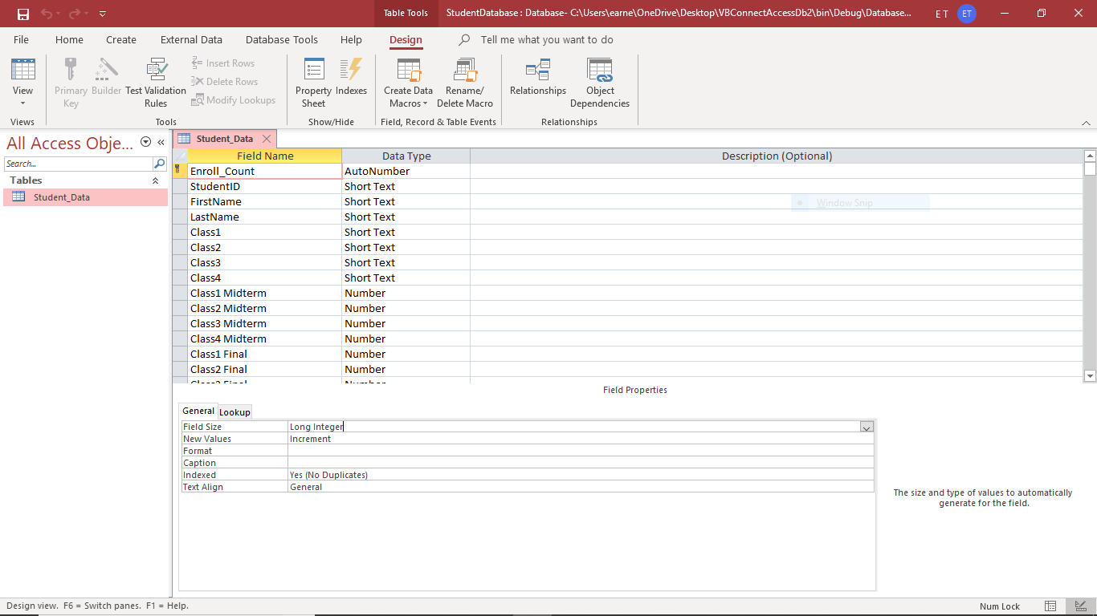
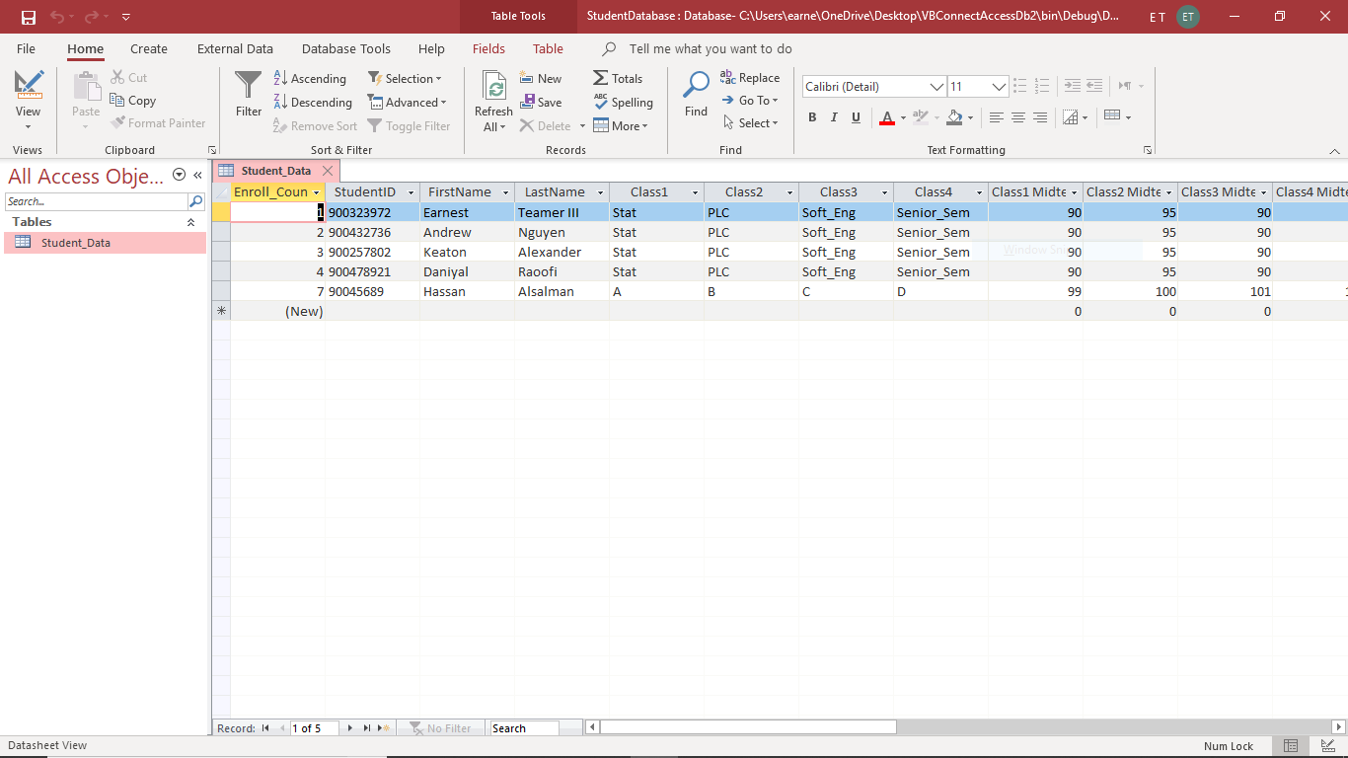
Database
Database where students are kept after being added to blackboard by the admin
Can also be removed when deleted from the blackboard

Slide 5
Login Page
Login button(admin): will give you access to the Administrative side of blackboard
Login button(Student): will give access to normal student side of blackboard

Slide 6
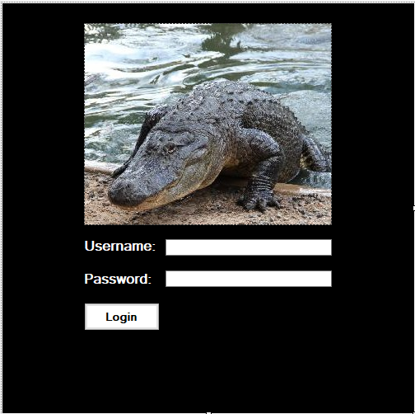
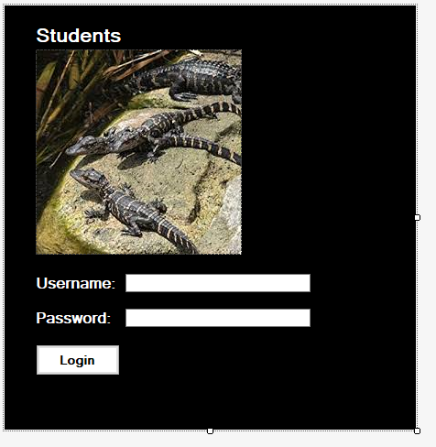
Student and admin login section
Enter admin username
Enter admin password
Login button gives access to administrator with correct login details
Enter student username
Enter student password
Login button gives access to students account with correct login details

Slide 7
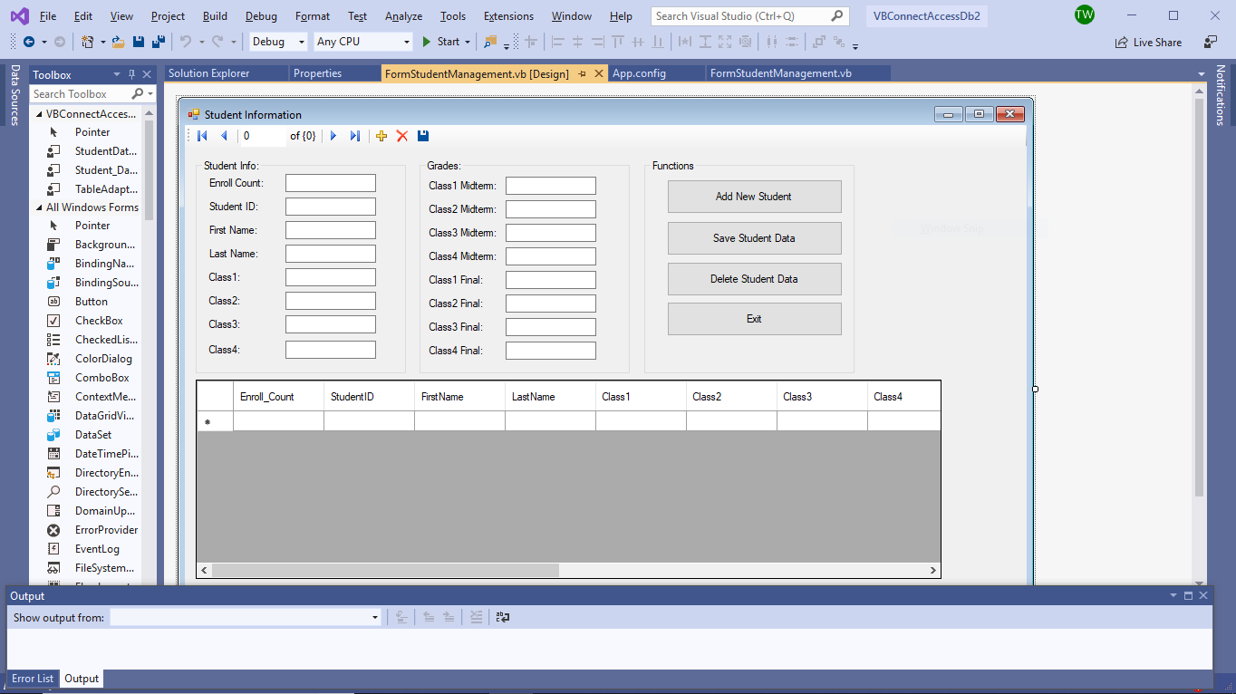
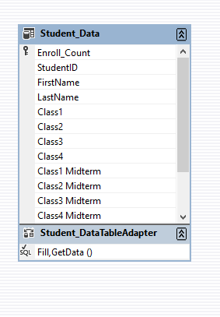
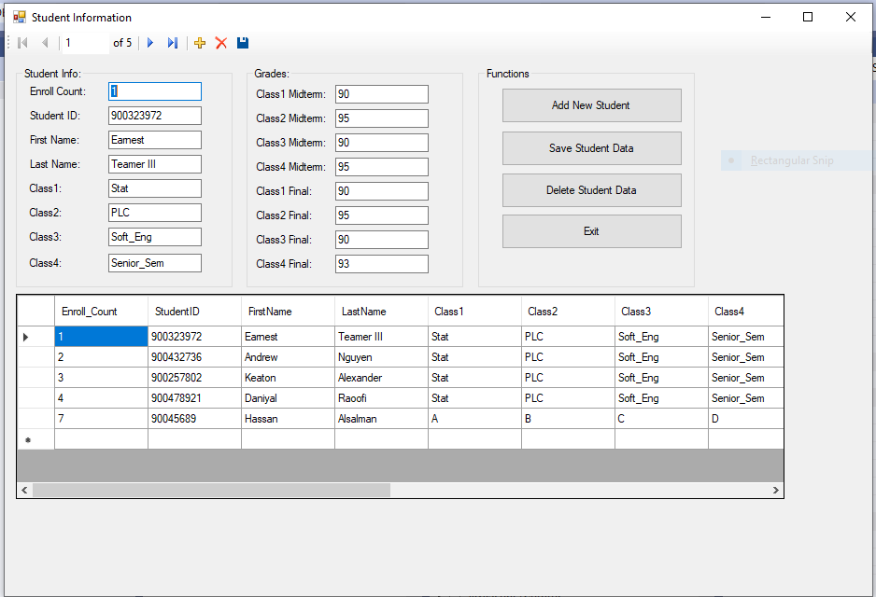
Adding/deleting/updating a student
Add new student button will add a new student after his information has been added to the system
Save student data will update an already added student on the system
Deleting student data will remove the student from the blackboard.
Exit will logout from the blackboard

Slide 8
FAILED PROJECTS: C#

